Slide 1
Why the HYPE?

Slide 2
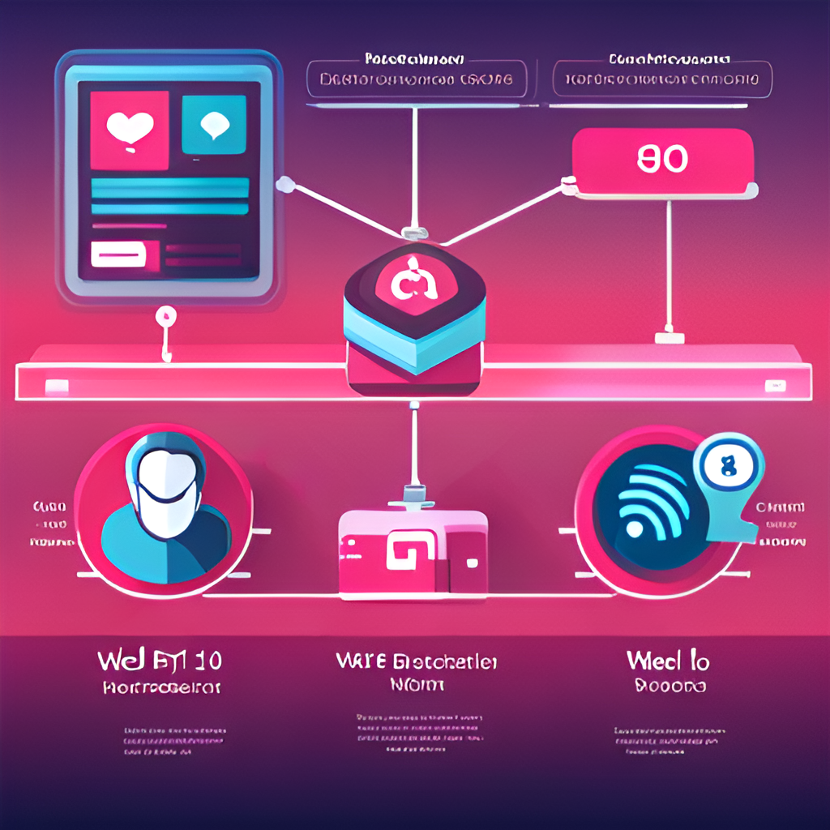
Differences between Web1.0, Web2.0 and Web3.0
Web1.0 was the first generation of the internet where users could only consume information without contributing to it. Websites were static and lacked interactivity
Web2.0 introduced dynamic websites with user-generated content and social media platforms. Users could now interact with each other and contribute to the content.
Web3.0 is the next evolution of the internet where decentralized applications (dApps) and blockchain technology are used to create a more secure and transparent web. Web3.0 aims to solve the problems of centralization and privacy by using decentralized networks and cryptography. It allows for peer-to-peer transactions without the need for intermediaries

Slide 3
In my opinion, the Hype is all about Cryptocurrency. The sudden rise in price of Bitcoin and Ethereum made every common man curious and to made them to invest.
Besides that, The Technology is so interesting…We don’t need to share our personal data to anyone in order to make payments. And the whole data is public which means one can verify the other transactions without actually knowing about themselves.
~ Personal opinions

Slide 4

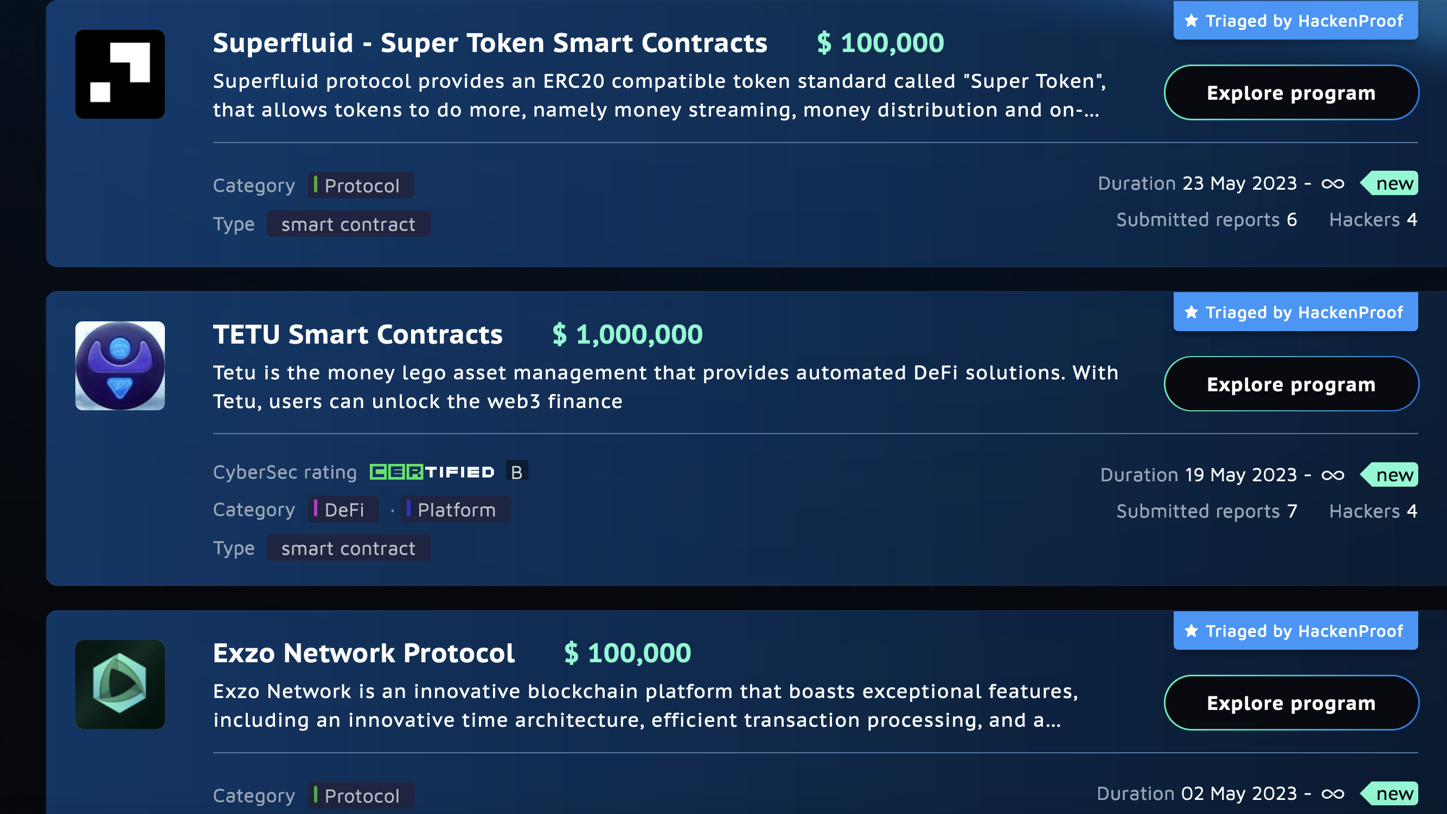
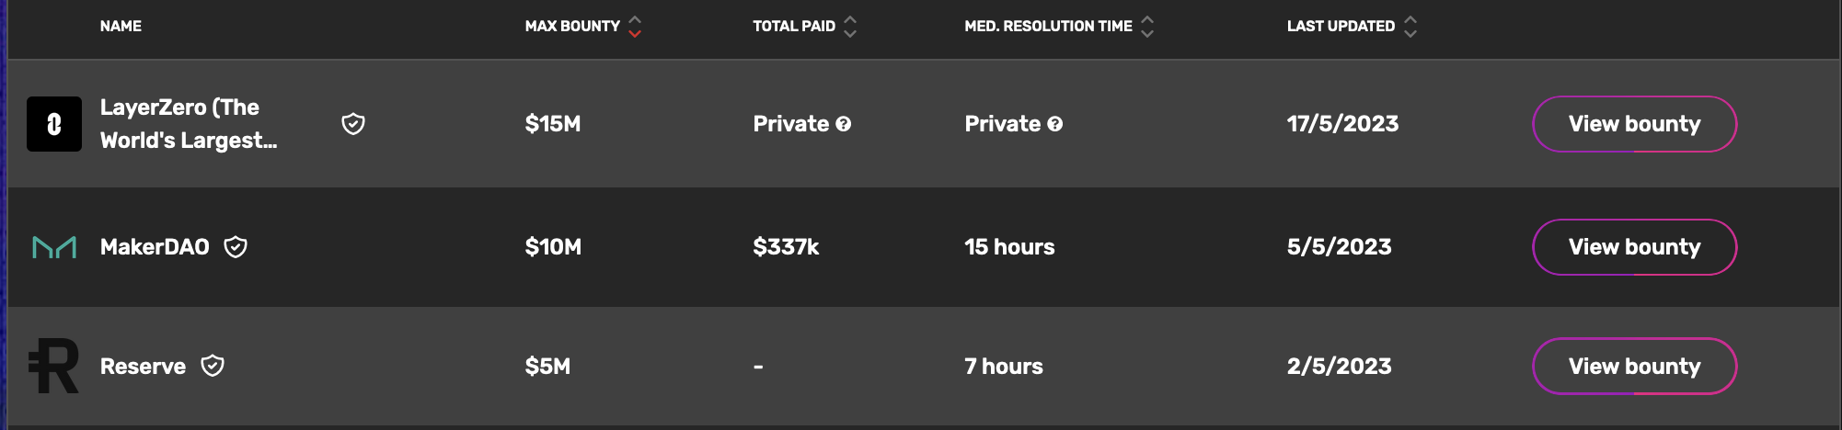
Another reason why people are moving towards Web3 Security is because of “MONEY💰”.

Slide 5
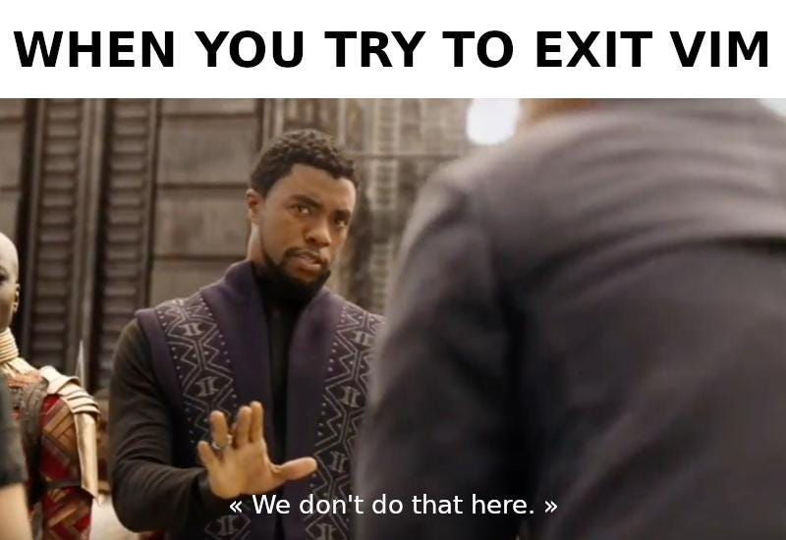
Learning Web3 Security is Easy!

Slide 6


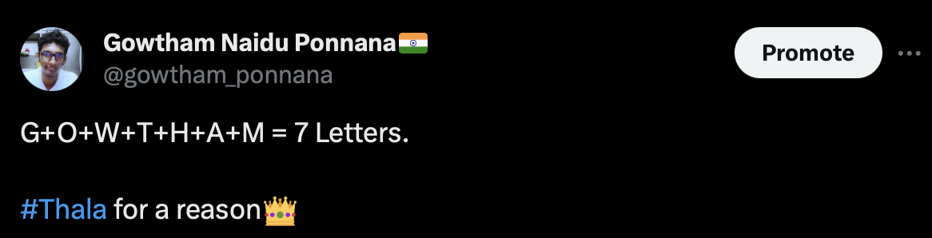
Who is msg.sender?
I’m Gowtham Naidu Ponnana, an 18y/o Security Researcher.
Top Researcher of Year 2022 @HackenProof.
< 250th Ranking on @Immunefi [More than 6 paid vulnerabilities] & 34th on Hackenproof
Head of Security
Security Researcher
Secured/Hacked more than 40+ Crypto-platforms & 20+companies. ( saving around $400M - $500M )

Slide 7
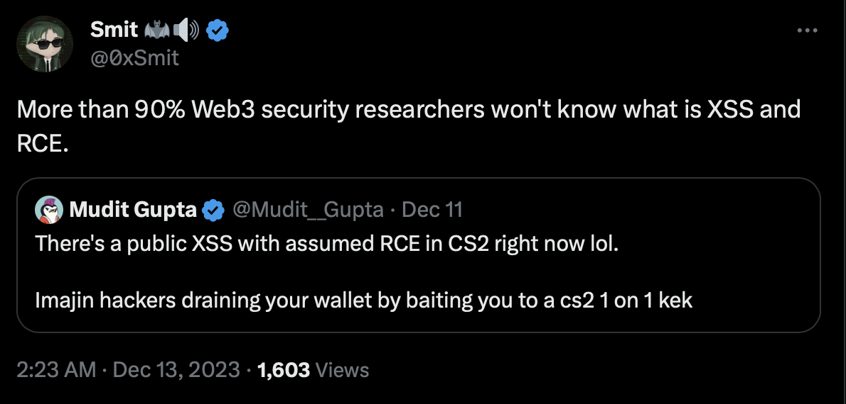
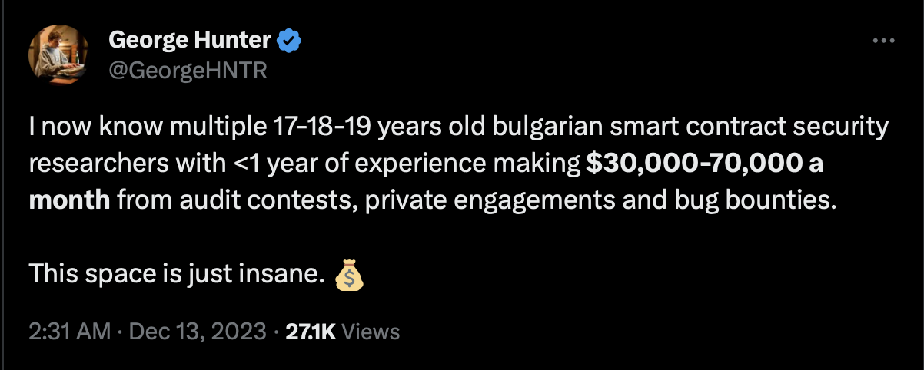
The Reasons to start into Web3 Security:

Slide 8
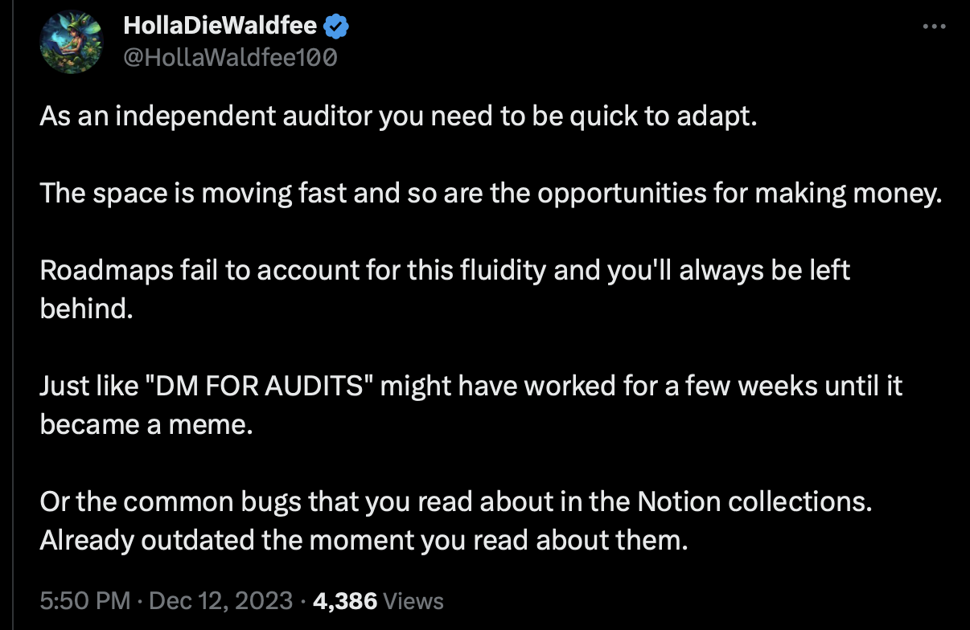
Perfect way to get started into WEB3 Security exists [RoadMap] - The Myth

Slide 9

Roadmap that “WORKED”
Understanding the Cryptography
Blockchain Basics
Solidity and Ethereum
Attacks and their fixes!
Learning…

Slide 10
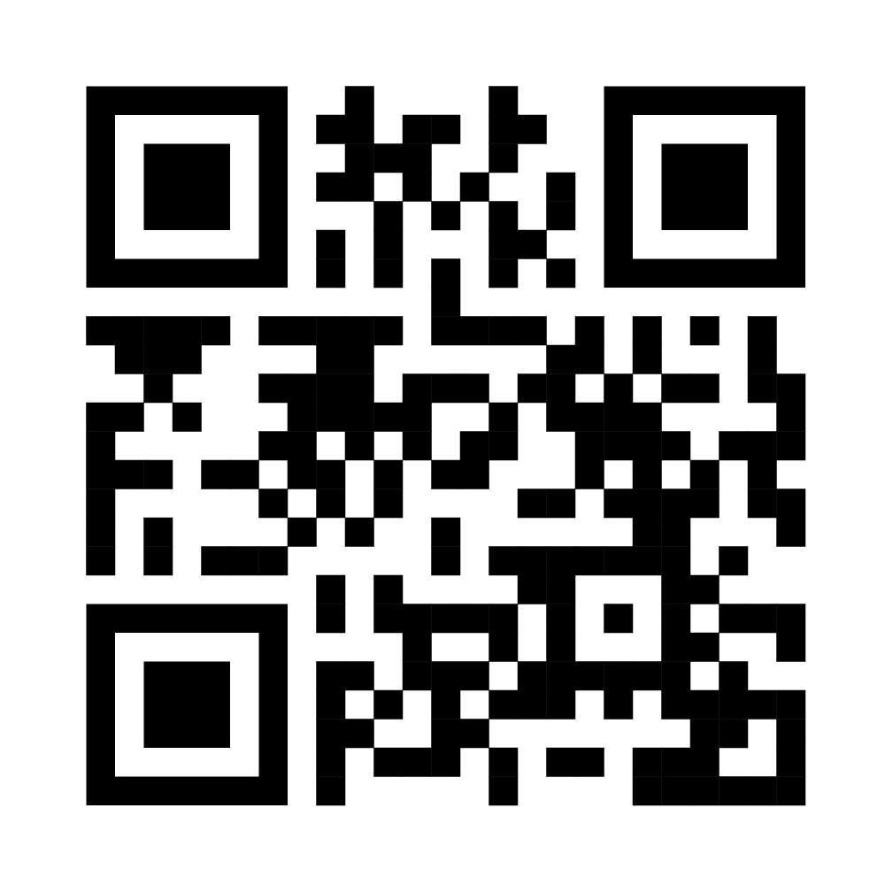
1) Understanding the Cryptography
Before starting out you should understand the technology itself. It’s mandatory to learn about Encryptions and Algorithms. Few things you should learn:
What is Encryption?
Difference between Symmetric Encryption & Asymmetric Encryption
What are Digital Signatures / Asymmetric Signing

Slide 11
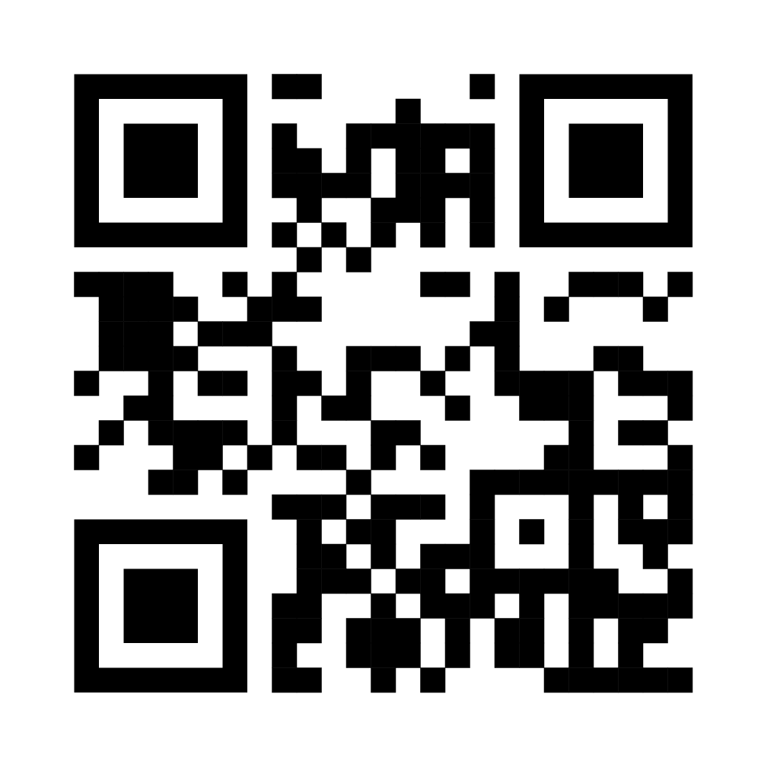
2) Blockchain and Bitcoin
Once you’re good with cryptography, you’re eligible to learn Blockchain specifically how it works. Few things you should learn:
What is Blockchain and How it works!
Bitcoin Whitepaper [ Never Ever Neglect it! ]
source: https://bitcoin.org/bitcoin.pdf

Slide 12
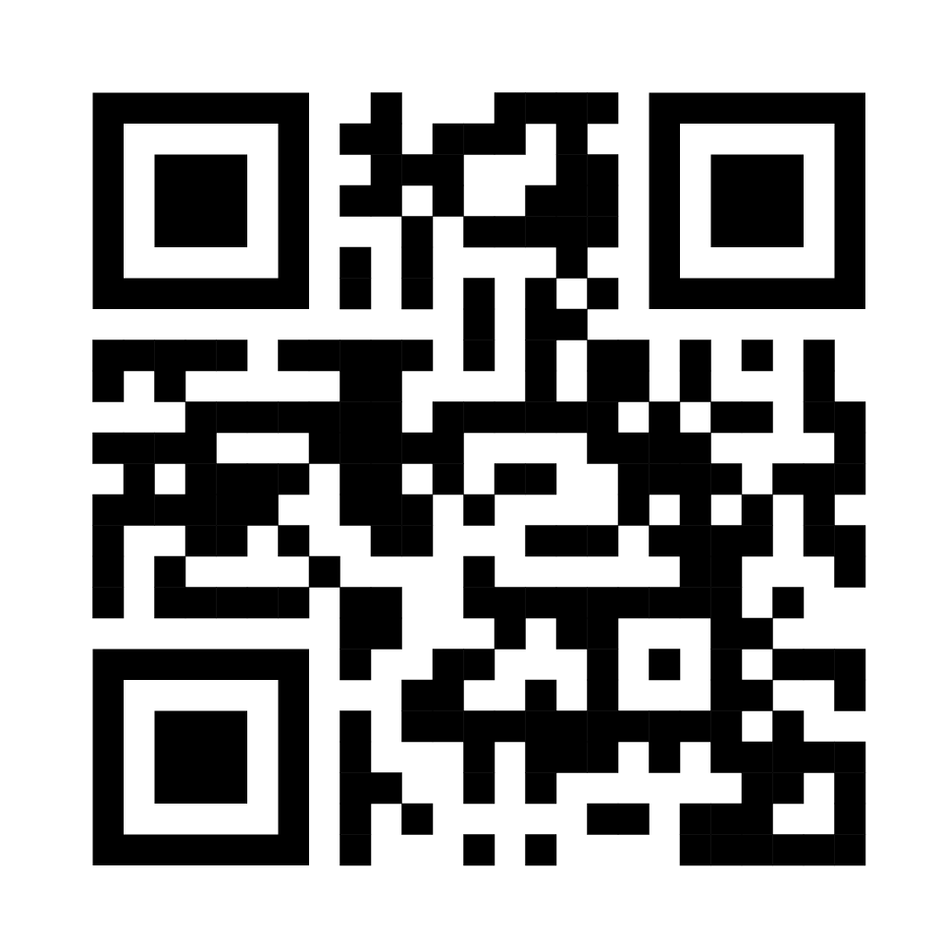
3) Learn Ethereum Blockchain & Solidity
After getting through the Bitcoin Whitepaper, you must know how blockchain works and all the necessary stuff.
It is high time where you need to dig deeper into Ethereum blockchain as most of the blockchains are EVM compatible.
Few things you should learn:
Ethereum Blockchain {Ethereum WhitePaper/ Ethereum Book}
Solidity Basics
sources:
cryptozombies.io
solidity-by-example.org
Solidity 101 & Solidity 201 [Secureum]

Slide 13
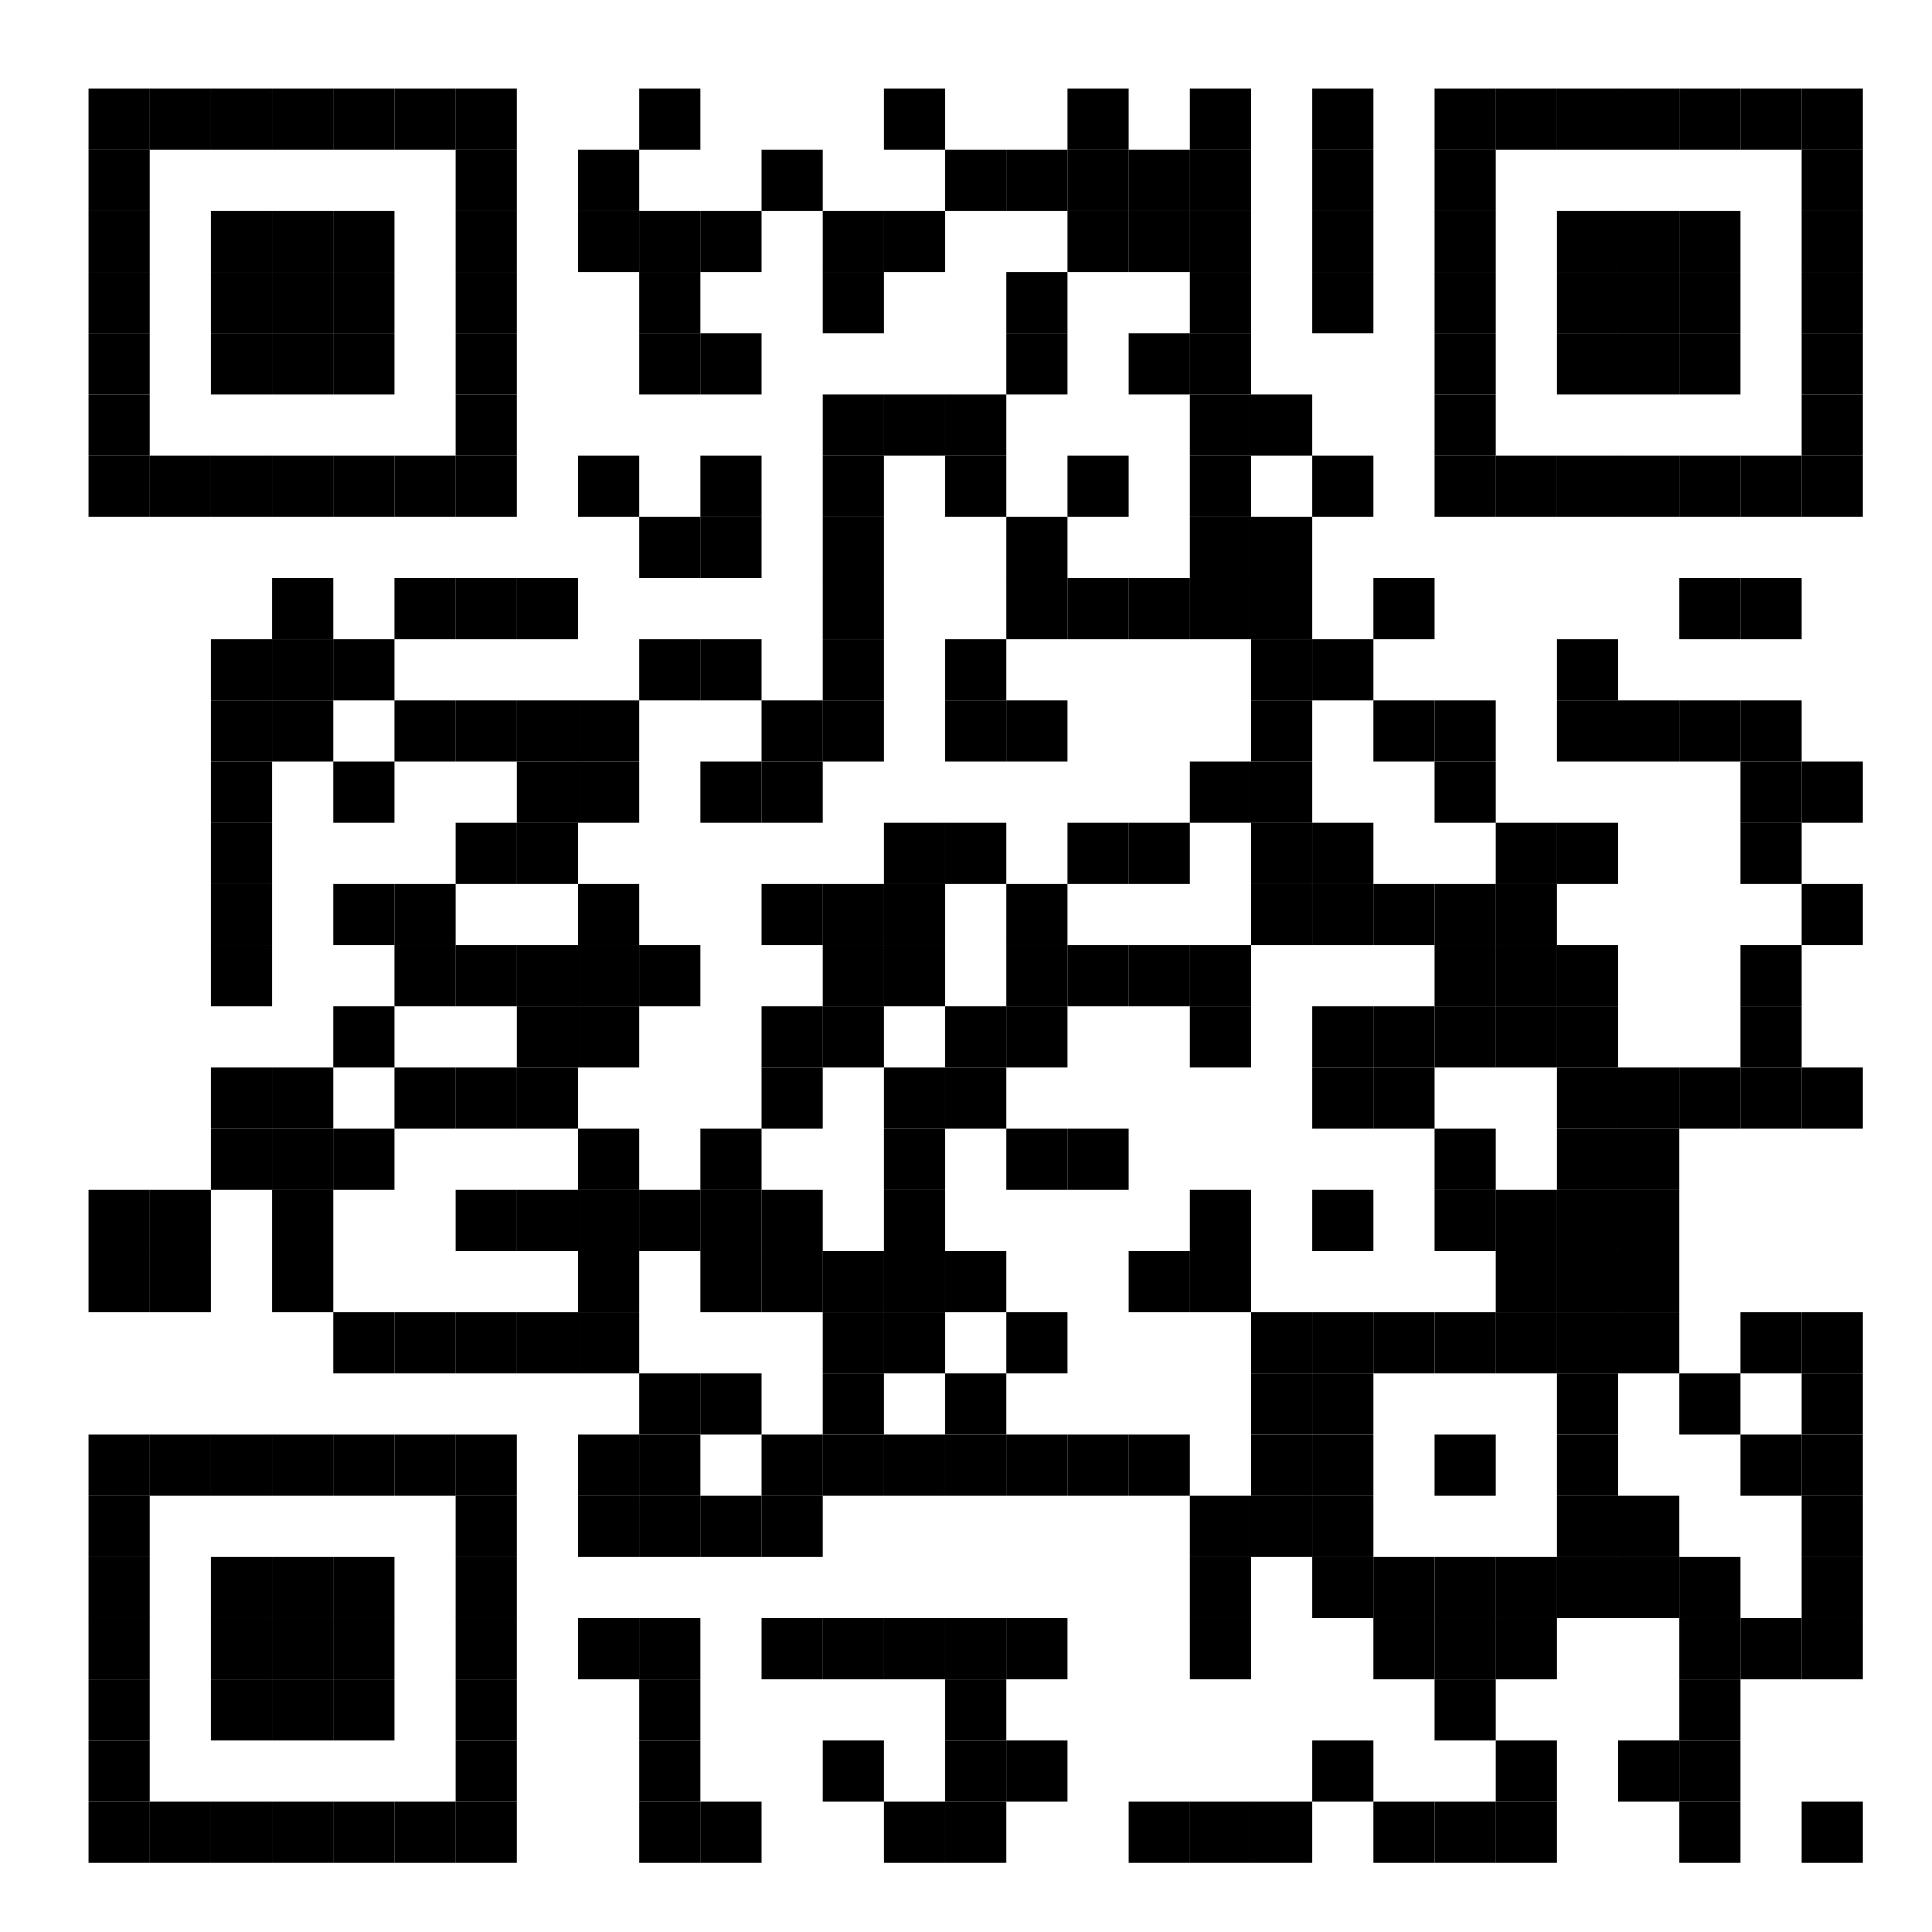
4) Attack Vectors and their Defenses
If you’re good with Solidity, it’s time to jump into Exploiting part. Here you should understand and need to spot vulnerabilities in smart contracts. Few things to learn:
Understanding of common vulnerabilities
Playing CTFs as much as possible.
sources:
capturetheether.com
ethernaut.openzeppelin.com
damnvulnerabledefi.xyz
https://github.com/runtimeverification/verified-smart-contracts/wiki/List-of-Security-Vulnerabilities

Slide 14
It’s Just the Beginning!

Slide 15
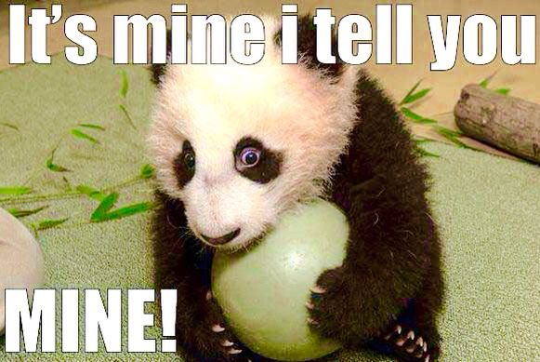
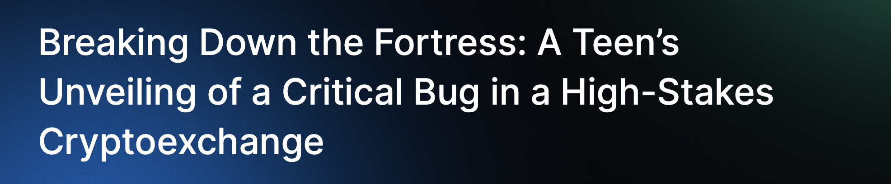
Ex-1: Why Web2 Researchers in Web3?
Though I find bugs in Smart Contracts, sometimes I somehow ended up digging into their web security.
Bug Classification: Authentication Vulnerablities
CVSS Score: 10
Funds at Risk: $400M - $500M
(Source: HackenProof)

Slide 16
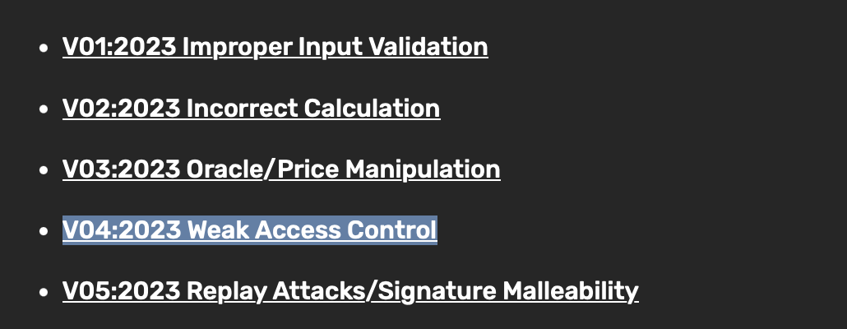
Ex-2: Access Control Stuff Again?
Function modifiers are used to modify the behaviour of a function. In simple terms, it adds a “CHECK” or “Authorization” to your function.
Sometimes, Developers tend to miss out placing Modifiers on some functions and it can lead to some Access Control Vulnerabilities.
Recommendations: Make sure there are modifiers set on some crucial functions.
(source: Immunefi )

Slide 17
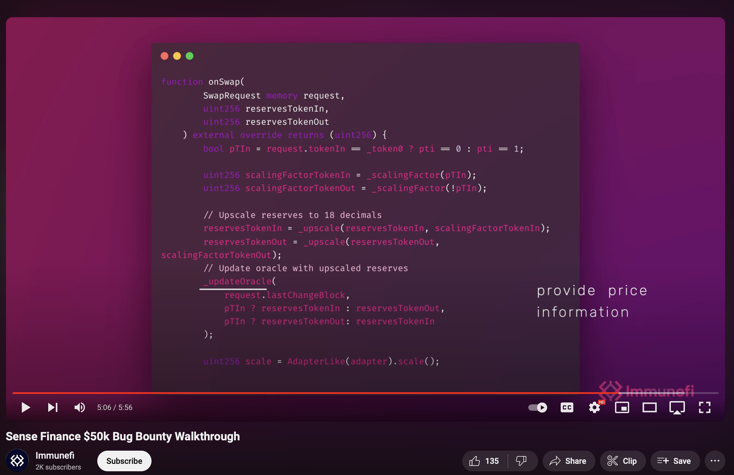
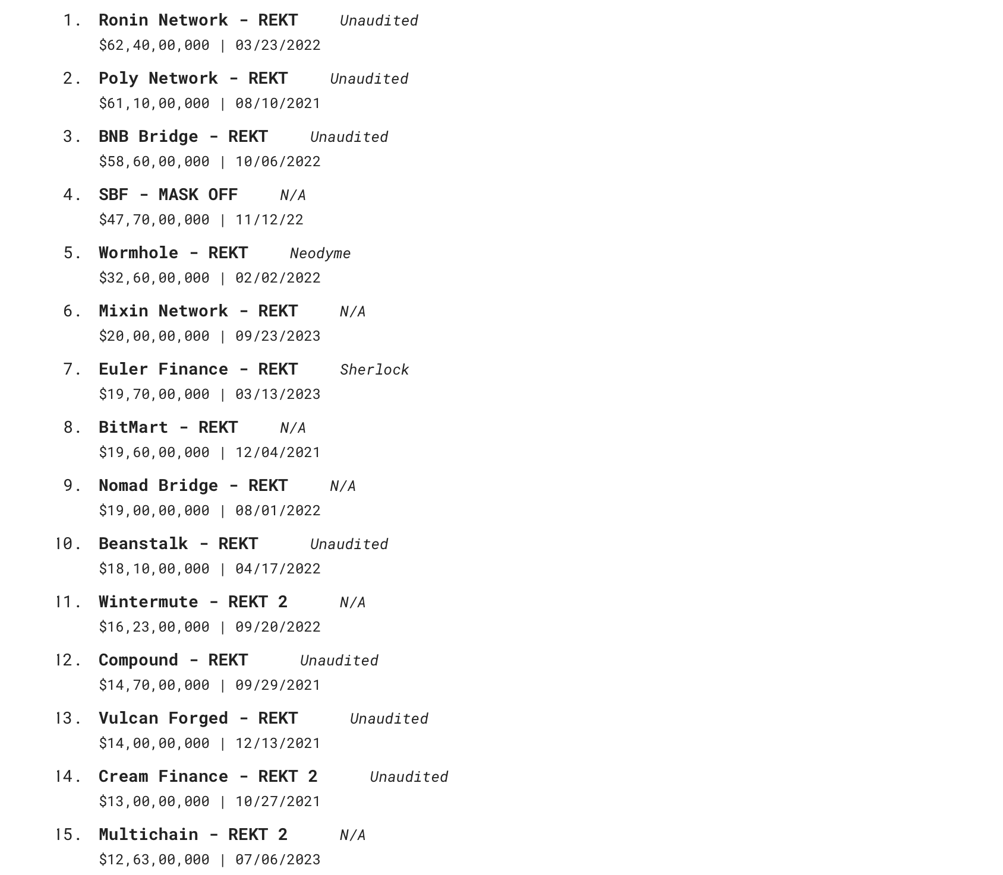
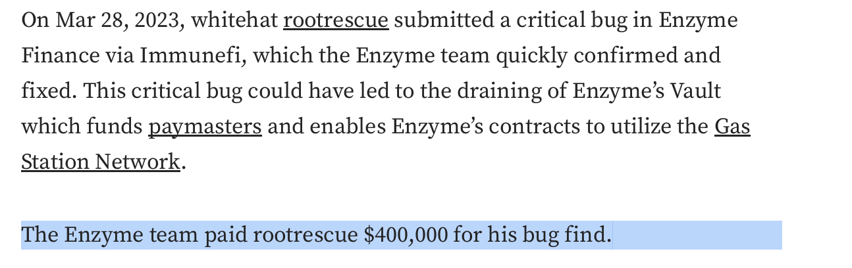
Lemme show you the moneyyyyy!!
(source: Rekt.News)

Slide 18

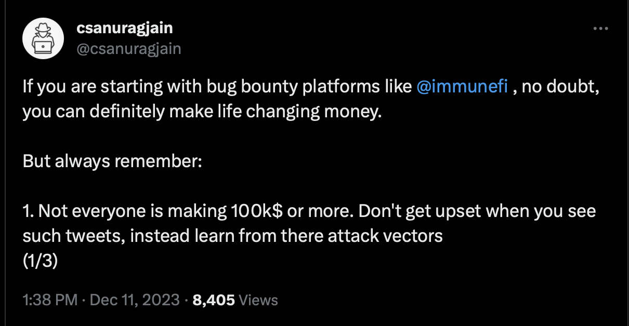
“Final Words”

Slide 19

Let’s remove some stuff

Slide 20





Thanks for sticking till the END!
You can always drop me a DM(Direct Message) at :
@Gowtham_Ponnana
@Gowtham_Ponnana
@Gowtham-ponnana
@gowtham-naidu [ Only For reading some Awesome blogs ]

